Slide 1


Big Data Infrastructure
CS 489/698 Big Data Infrastructure (Winter 2016)
Week 9: Data Mining (4/4)
March 10, 2016
Jimmy Lin
David R. Cheriton School of Computer Science
University of Waterloo
These slides are available at http://lintool.github.io/bigdata-2016w/
This work is licensed under a Creative Commons Attribution-Noncommercial-Share Alike 3.0 United States See http://creativecommons.org/licenses/by-nc-sa/3.0/us/ for details

Slide 2
What’s the Problem?
Arrange items into clusters
High similarity (low distance) between items in the same cluster
Low similarity (high distance) between items in different clusters
Cluster labeling is a separate problem

Slide 3
Compare/Contrast
Finding similar items
Focus on individual items
Clustering
Focus on groups of items
Relationship between items in a cluster is of interest

Slide 4
Evaluation?
Classification
Finding similar items
Clustering

Slide 5
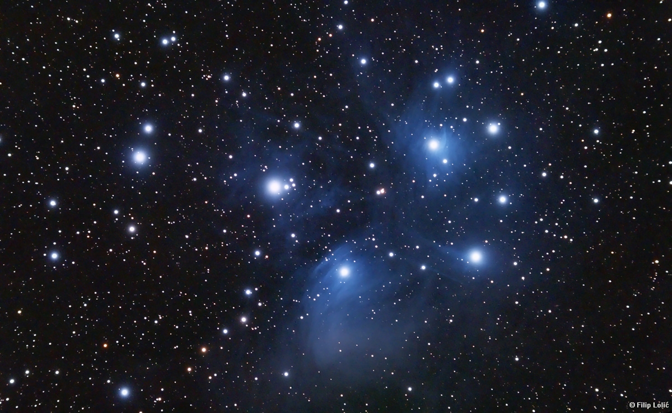
Clustering
Source: Wikipedia (Star cluster)

Slide 6
Clustering
Specify distance metric
Jaccard, Euclidean, cosine, etc.
Compute representation
Shingling, tf.idf, etc.
Apply clustering algorithm

Slide 7

Distances
Source: www.flickr.com/photos/thiagoalmeida/250190676/

Slide 8
Distance Metrics
Non-negativity:
Identity:
Symmetry:
Triangle Inequality

Slide 9
Distance: Jaccard
Given two sets A, B
Jaccard similarity:

Slide 10
Distance: Hamming
Given two bit vectors
Hamming distance: number of elements which differ

Slide 11
Distance: Norms
Given:
Euclidean distance (L₂-norm)
Manhattan distance (L₁-norm)
L_{r}-norm

Slide 12
Distance: Cosine
Given:
Idea: measure distance between the vectors
Thus:
Advantages over others?

Slide 13

Representations

Slide 14
Representations: Text
Unigrams (i.e., words)
Shingles = n-grams
At the word level
At the character level
Feature weights
boolean
tf.idf
BM25
…

Slide 15
Representations: Beyond Text
For recommender systems:
Items as features for users
Users as features for items
For graphs:
Adjacency lists as features for vertices
With log data:
Behaviors (clicks) as features

Slide 16
General Clustering Approaches
Hierarchical
K-Means
Gaussian Mixture Models

Slide 17
Hierarchical Agglomerative Clustering
Start with each document in its own cluster
Until there is only one cluster:
Find the two clusters c_{i} and c_{j}, that are most similar
Replace c_{i} and c_{j} with a single cluster c_{i} ∪ c_{j}
The history of merges forms the hierarchy

Slide 18
HAC in Action
A B C D E F G H

Slide 19
Cluster Merging
Which two clusters do we merge?
What’s the similarity between two clusters?
Single Link: similarity of two most similar members
Complete Link: similarity of two least similar members
Group Average: average similarity between members

Slide 20
Link Functions
Single link:
Uses maximum similarity of pairs:
Can result in “straggly” (long and thin) clusters due to chaining effect
Complete link:
Use minimum similarity of pairs:
Makes more “tight” spherical clusters

Slide 21
MapReduce Implementation
What’s the inherent challenge?

Slide 22
K-Means Algorithm
Let d be the distance between documents
Define the centroid of a cluster to be:
Select k random instances {s₁, s₂,… s_{k}} as seeds.
Until clusters converge:
Assign each instance x_{i} to the cluster c_{j} such that d(x_{i}, s_{j}) is minimal
Update the seeds to the centroid of each cluster
For each cluster c_{j}, s_{j} = μ(c_{j})

Slide 23
K-Means Clustering Example
Pick seeds
Reassign clusters
Compute centroids
Reassign clusters
◉
◉
Compute centroids
◉
◉
Reassign clusters
Converged!

Slide 24
Basic MapReduce Implementation
(Just a clever way to keep track of denominator)

Slide 25
MapReduce Implementation w/ IMC
What about Spark?

Slide 26
Implementation Notes
Standard setup of iterative MapReduce algorithms
Driver program sets up MapReduce job
Waits for completion
Checks for convergence
Repeats if necessary
Must be able keep cluster centroids in memory
With large k, large feature spaces, potentially an issue
Memory requirements of centroids grow over time!
Variant: k-medoids

Slide 27
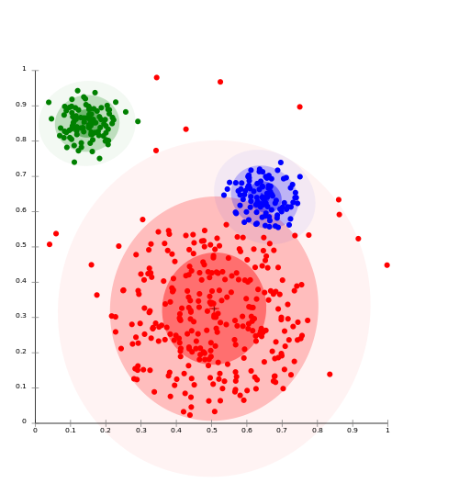
Clustering w/ Gaussian Mixture Models
Model data as a mixture of Gaussians
Given data, recover model parameters
Source: Wikipedia (Cluster analysis)

Slide 28
Gaussian Distributions
Univariate Gaussian (i.e., Normal):
A random variable with such a distribution we write as:
Multivariate Gaussian:
A vector-value random variable with such a distribution we write as:

Slide 29
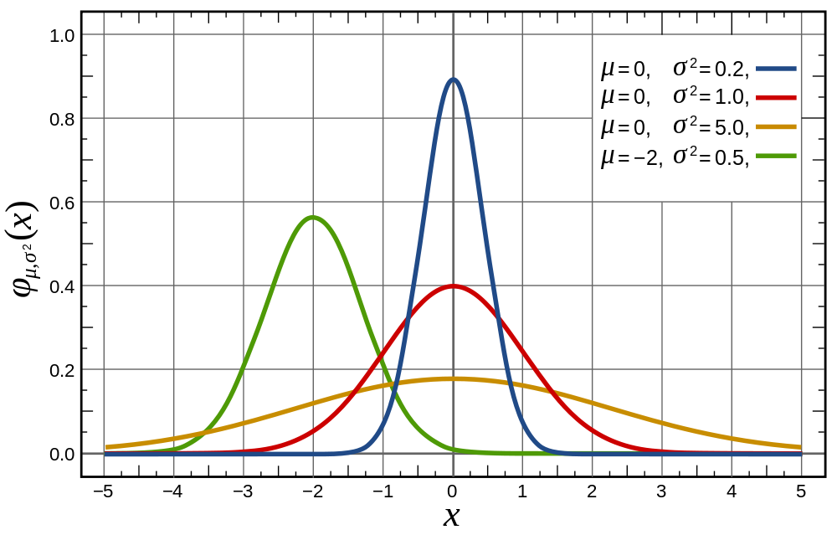
Univariate Gaussian
Source: Wikipedia (Normal Distribution)

Slide 30
Multivariate Gaussians
Source: Lecture notes by Chuong B. Do (IIT Delhi)

Slide 31
Gaussian Mixture Models
Model parameters
Number of components:
“Mixing” weight vector:
For each Gaussian, mean and covariance matrix:
Varying constraints on co-variance matrices
Spherical vs. diagonal vs. full
Tied vs. untied
The generative story?
(yes, that’s a technical term)

Slide 32
Learning for Simple Univariate Case
Problem setup:
Given number of components:
Given points:
Learn parameters:
Model selection criterion: maximize likelihood of data
Introduce indicator variables:
Likelihood of the data:

Slide 33
EM to the Rescue!
We’re faced with this:
It’d be a lot easier if we knew the z’s!
Expectation Maximization
Guess the model parameters
E-step: Compute posterior distribution over latent (hidden) variables given the model parameters
M-step: Update model parameters using posterior distribution computed in the E-step
Iterate until convergence

Slide 34
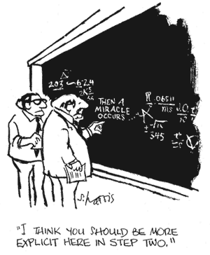

Slide 35
EM for Univariate GMMs
Initialize:
Iterate:
E-step: compute expectation of z variables
M-step: compute new model parameters

Slide 36
MapReduce Implementation
x₁
z_{1,1}
z_{1,2}
…
z_{1,K}
Map
x₂
z_{2,1}
z_{2,2}
z_{2,K}
x₃
z_{2,1}
z_{2,3}
z_{2,K}
…
x_{N}
z_{N,1}
z_{N,2}
z_{N,K}
Reduce
What about Spark?

Slide 37
K-Means vs. GMMs
K-Means
GMM
Map
Compute distance of points to centroids
E-step: compute expectation of z indicator variables
Reduce
M-step: update values of model parameters
Recompute new centroids

Slide 38
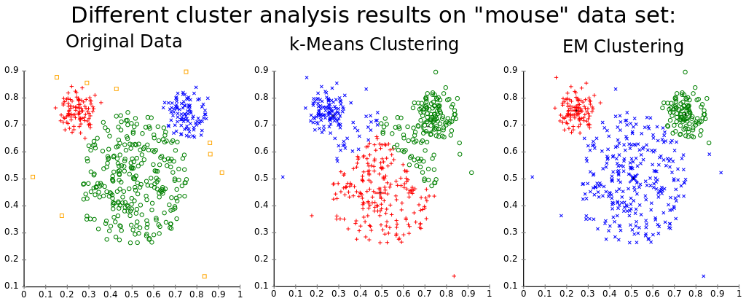
Source: Wikipedia (k-means clustering)

Slide 39

Questions?
Source: Wikipedia (Japanese rock garden)

